Slide 1


Hazelcast ımdg
Anıl Can ÖZGÖK
27.09.2022

Slide 2
Contents
What is IMDG?
What is Hazelcast IMDG?
How do Hazelcast IMDG works?
Pros and Cons
In which cases should we use Hazelcast IMDG?
Example usage of Hazelcast IMDG
References

Slide 3
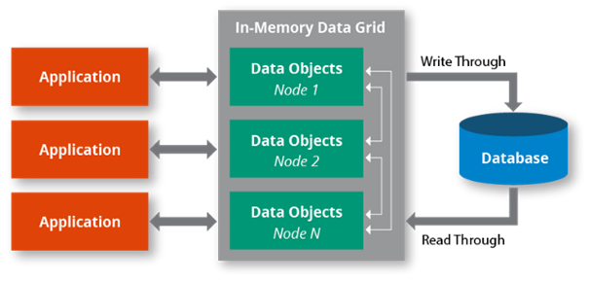
What ıs IMDG?
Before we talk about Hazelcast, first we need to know what is IMDG “in-memory data grid”. IMDG is a combination of computers (JVMs for Hazelcast) to store data by creating a common repo in RAM. This way, different apps can Access the data that stored in the common repo, and since data comes from RAM our read and write performance increases.

Slide 4

What ıs Hazelcast IMDG?
Hazelcast IMDG is an open-source, java-based distributed in-memory data grid that supports a wide variety of data structures. The logic of Hazelcast is that it brings several JVM together and benefits their power. Also, Hazelcast attaches great importance to the data it stores.
We can use Hazelcast IMDG to store our data in RAM, spread and replicate it across your cluster of machines, and perform computations on it. Replication gives you the resilience to failures of cluster members.
Hazelcast IMDG is highly scalable and available. Distributed applications can use it for distributed caching, synchronization, clustering, processing, pub/sub (Publish-Subscribe Pattern) messaging, etc.

Slide 5
What ıs Hazelcast IMDG?
It is implemented in Java language and has clients for Java, C++, .NET, Python, Go, and Node.js. Hazelcast IMDG also speaks Memcached and REST protocols. It plugs into Hibernate and can easily be used with any existing database system.
Since Hazelcast IMDG is just a JAR file it is very easy to include in your project and it has no dependency other than Java.

Slide 6
What ıs Hazelcast IMDG?
Hazelcast IMDG supports the following data structures, not just strings.
List
Sets
Queue
Map
There is no size limitation for Hazelcast but we should keep in mind that more size means more members and it causes latency.

Slide 7
How does Hazelcast IMDG works?
Like we said the earlier Hazelcast works were distributed. Clustering is automatically done by Hazelcast. Hazelcast Members are configured to access each other from a cluster among themselves.
Hazelcast stores the data distributed in every existing cluster member. So the data has multiple backups in each cluster member. This way our data loss risk minimizes. Data synchronizes with every cluster member when a new member is added to the cluster.
While reading actions, Hazelcast searches data in local members thus it minimizes network traffic.

Slide 8
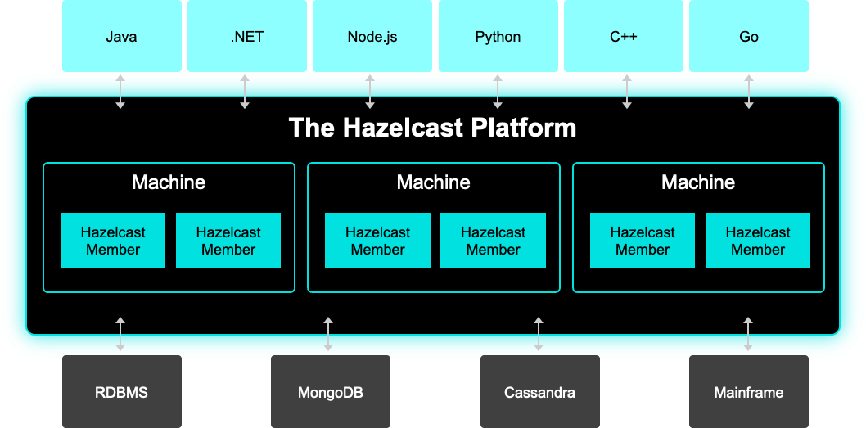
How do Hazelcast IMDG works?

Slide 9
Pros and cons
Pros
cons
Open sources.
Only a JAR file. Don’t need any dependency other than Java.
Stores data in RAM thus it is fast in reading/writing.
Members are always in connection with each other.
Risk of data loss is minimal.
More member means more network traffic.
More likely to be affected by a fail on the network compared to single instance caches.
Since the members are working on the same server with the application, it can be open to failing in case of server overload or GC

Slide 10
In whıch cases should we use Hazelcast ımdg?
If the data is to be distributed to several servers,
If the data is to be cached (distributed cache),
If the application is to be clustered,
If secure communication is to be provided between servers,
If the data in RAM is to be partitioned,
If the work is to be distributed to many servers
If we want to use the benefits of parallel processing,
If the data management will be implemented without data loss.
In these cases, we should use Hazelcast.

Slide 11
Example usage of Hazelcast IMDG
Include Hazelcast into your Project using Maven
Use wherever you want !
<dependency>
<groupId>com.hazelcast</groupId>
<artifactId>hazelcast</artifactId>
<version>3.5.3</version>
</dependency>
Config cfg = new Config();
HazelcastInstance instance = Hazelcast.newHazelcastInstance(cfg);
import
Use wherever you want !
import com.hazelcast.core.*;
import com.hazelcast.config.*;
Map<Integer, String> mapKisi = instance.getMap("kisi");
mapKisi.put(1, "Burak");
mapKisi.put(2, "Ahmet");

Slide 12
References
https://docs.hazelcast.com/imdg/4.2/overview/what-is-imdg
https://tr.wikipedia.org/wiki/Hazelcast
https://en.wikipedia.org/wiki/Hazelcast
https://prezi.com/l3lkzbjsphd6/hazelcast/
https://medium.com/@nurdankaya/hazelcast-7124c61fa43c
https://blog.burakkutbay.com/hazelcast-nedir.html/
https://bilgisayarkavramlari.com/2012/11/07/caching-mekanizmalari/

Slide 13
Anıl Can ÖZGÖK
GitHub
https://github.com/anilozgok
LinkedIn
https://www.linkedin.com/in/anıl-can-özgök/
Thank you for your time.

